Slide 1




Professional Development Event
Personal Website Development – HKN

Slide 2
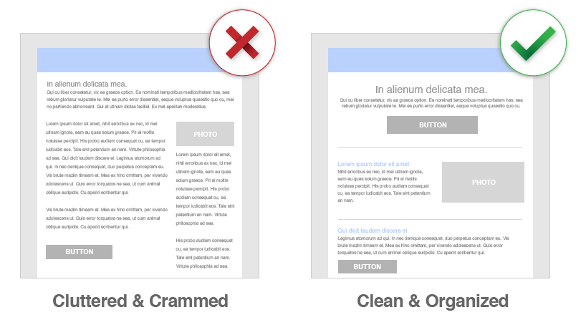


Good Modern Web Designs
Simplicity
Good use of color
Text that is easily read
Font size, line spacing, font type
Meaningful graphics
Easy to use
etc….. There are many more!
VS

Slide 3
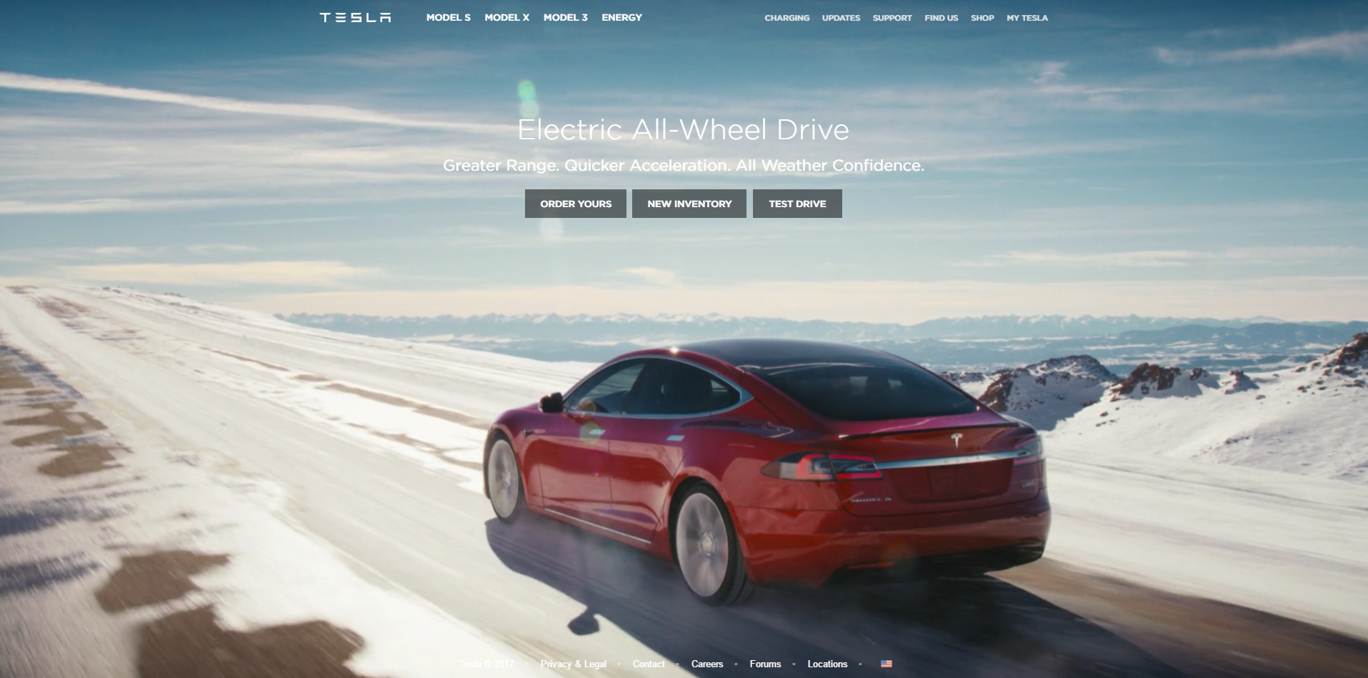
Good Design Examples
Main Text
Sub Text
Call-to-action buttons

Slide 4

Good Design Examples

Slide 5
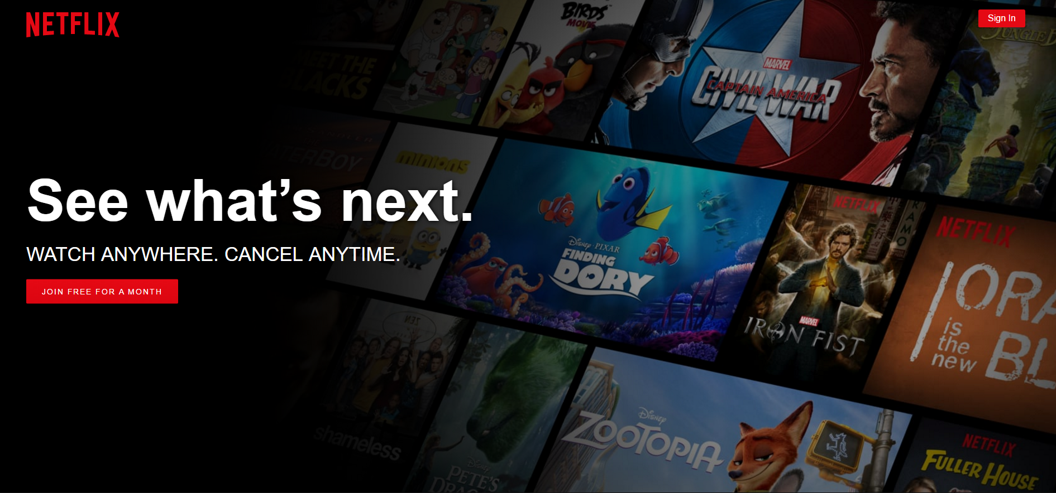
Good Design Examples

Slide 6
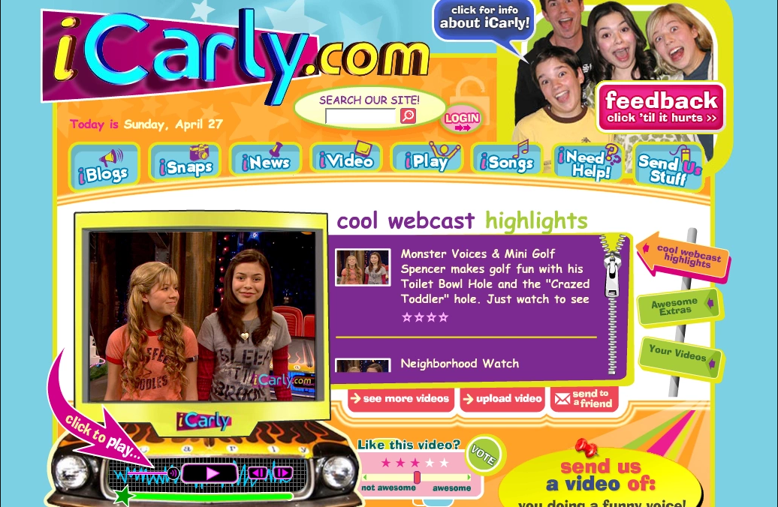
Bad Design Examples

Slide 7
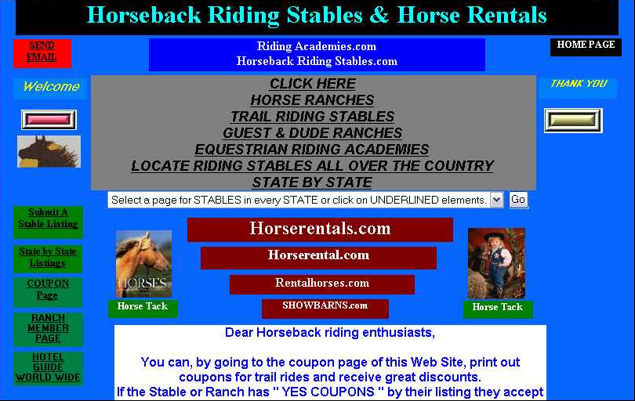
Bad Design Examples

Slide 8
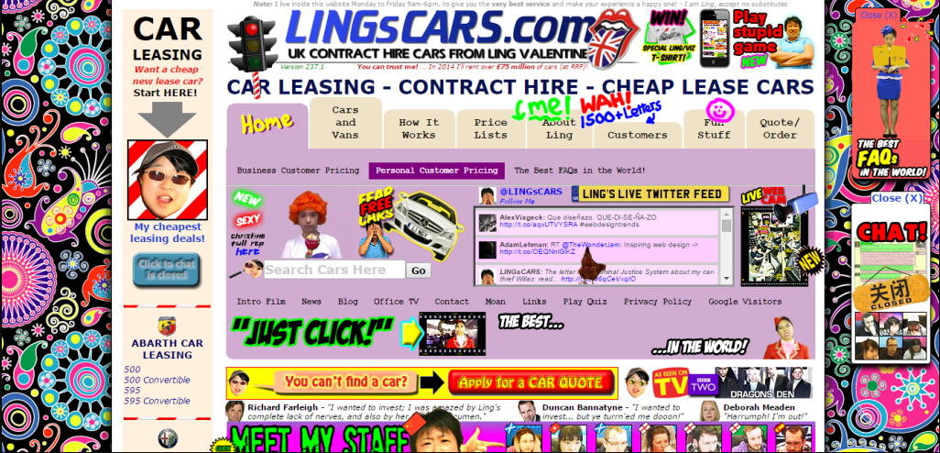
Bad Design Examples

Slide 9

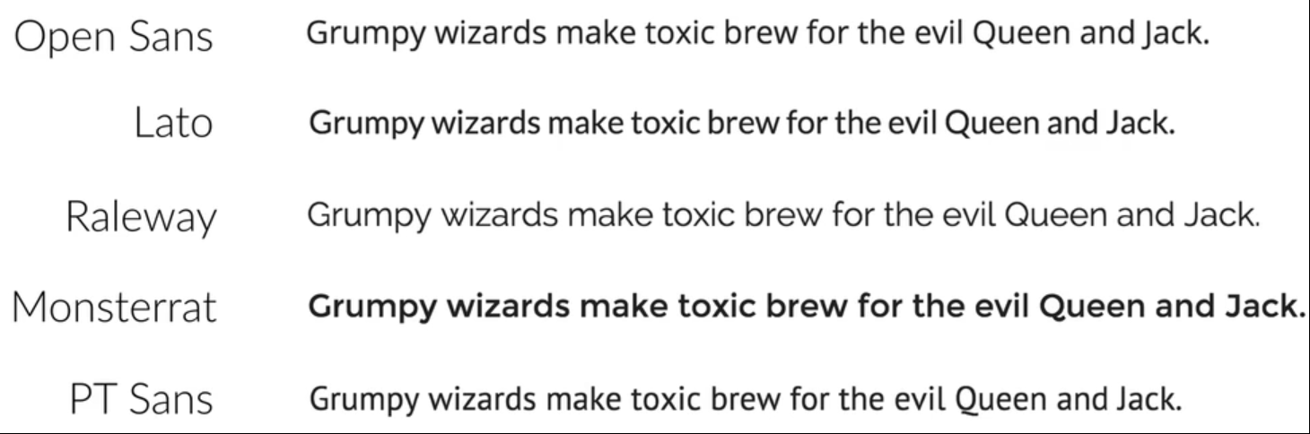
Good fonts to use…

Slide 10
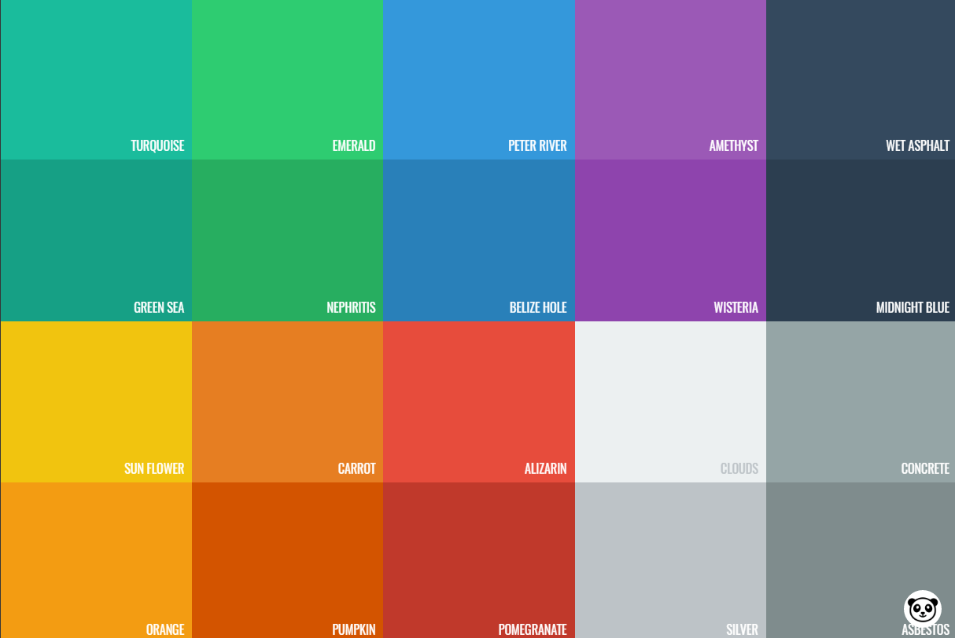
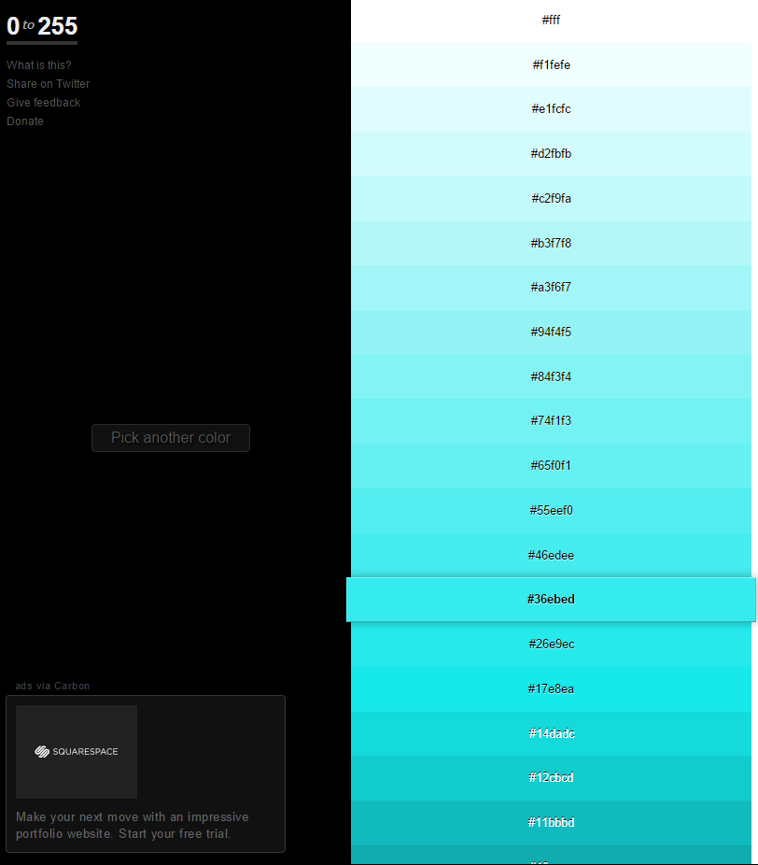
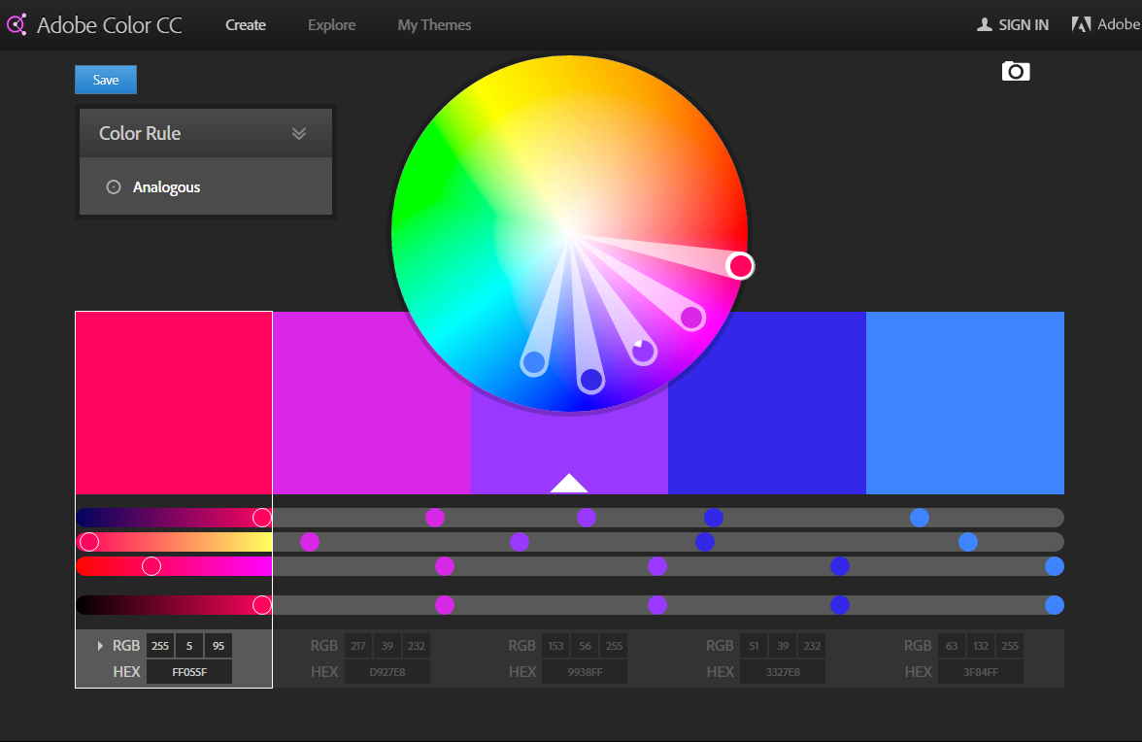
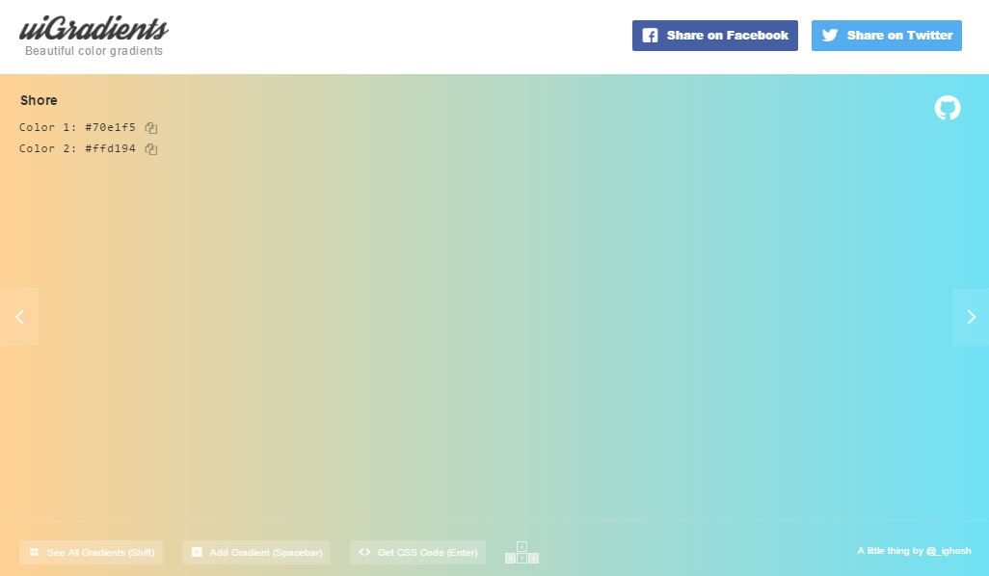
Colors
Use only ONE base color
Create color palettes
To mix colors..
Choose Carefully -> use a tool!
Use to draw attention
Don’t use Black
…..or other standard colors
Resources…
https://flatuicolors.com/
http://www.0to255.com/
https://color.adobe.com/create/color-wheel/
https://uigradients.com/

Slide 11

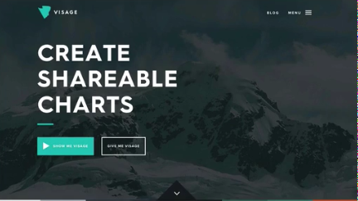



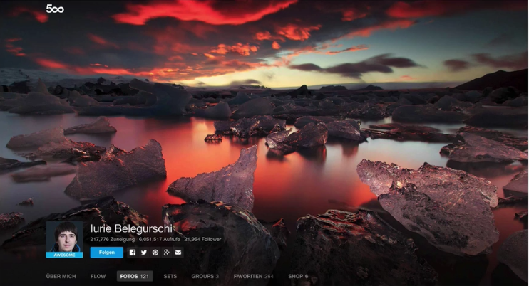
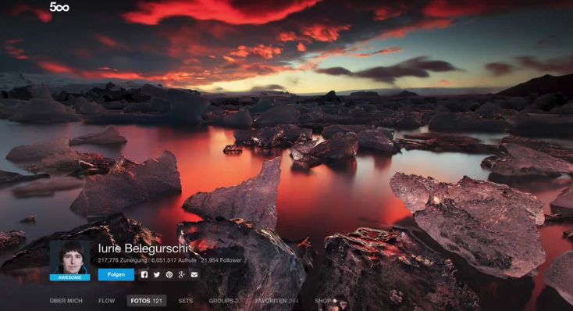
Working with Images
Put text directly on the Images (Difficult)
Watch out for unreadable texts due to images
Overlay the image
Black & White <= common, Gradients
Use a textbox !
Blur the Image
Floor fade

Slide 12
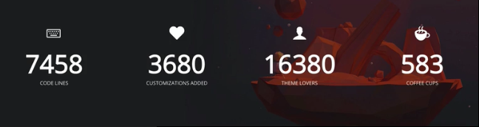
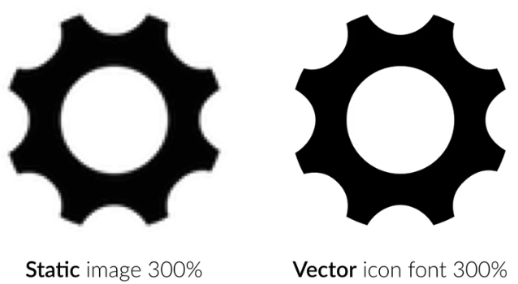
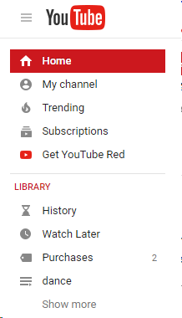
Using Icons
Use icons to list features/steps
Use icons for actions and links
Icons should be recognizable
Label your icons
Icons should not take a center stage
Use icon fonts whenever possible

Slide 13
Getting inspirations.
Use other websites as inspirations
See what leading designers are doing it right
Collect designs you like
Try to understand them
Ask questions:
Why do they look good?
What do they have in common?
STEAL like an Artist ! ☺

Slide 14

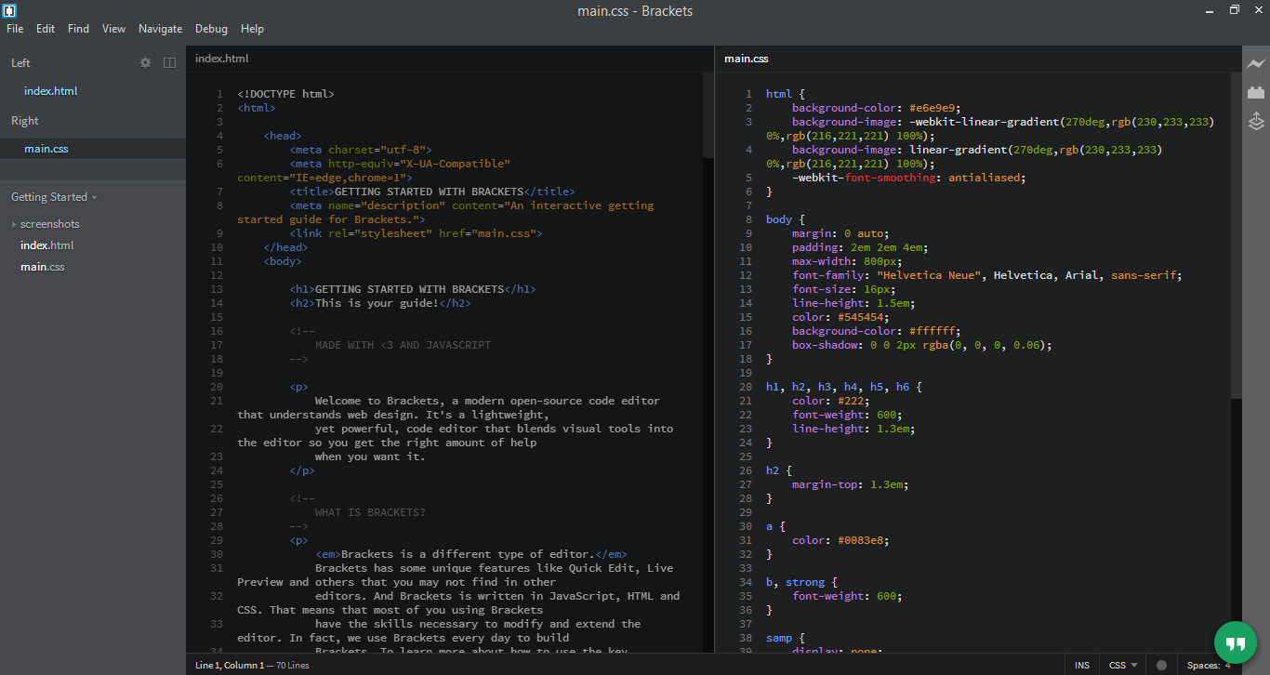
Tools – Text Editor
Brackets
Perfect web development tool
Offer many useful feature and plugins
Completely FREE ! ☺
Download Link
http://brackets.io/

Slide 15
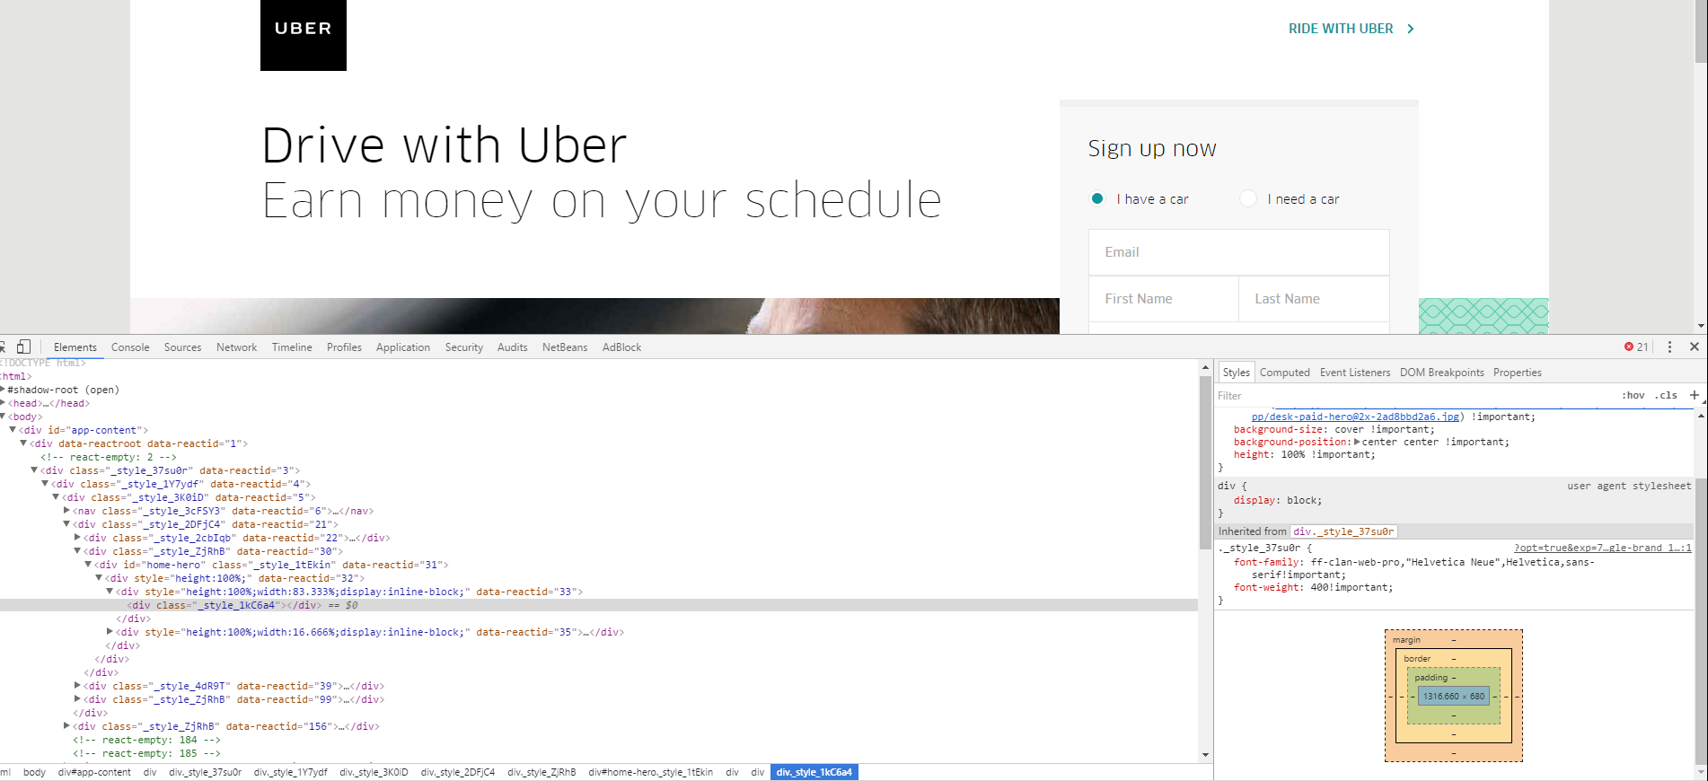
Debugging tool - Google Chrome
Easy-to-use
Ctrl + Shift + i => To inspect items
Shows
Source code
Stylesheet
Margin-border-padding layout

Slide 16
File Hierarchy Standard
Main directory
Index.html <= Entry point website
Public <= Imported code
CSS
HTML
JS
img
data
Private <= personal code
CSS
HTML
JS
img
data

Slide 17
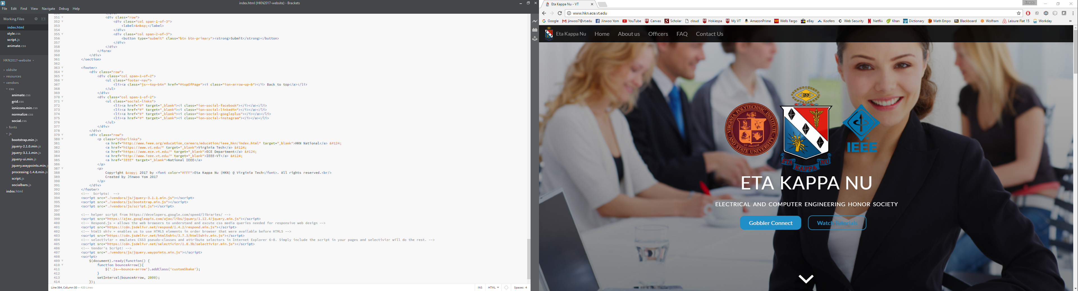
HTML – Hyper Text Markup Language
HTML documents are described by HTML tags
<h1> <p> <a>
Tags mark up the beginning and the end of an element
<TagName>content</TagName>
Browsers can render the HTML code into visible webpages

Slide 18
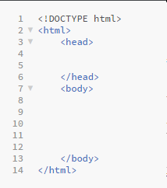
HTML Structure and common tags
Website settings go here
<h1> -> <h6> => heading tags
<p> => paragraph tag
<a> => anchor tag => for links
<br/> => line brake
<img src=“./folder/image.png”/> => Image tag
Styling
<strong> => bold
<em> => “empathize” => italic
<u> => underline
Website contents go here

Slide 19
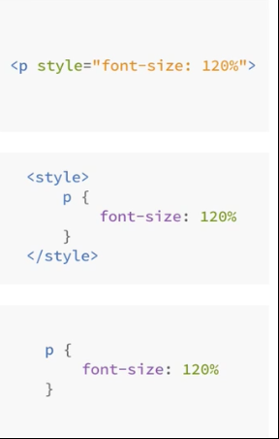
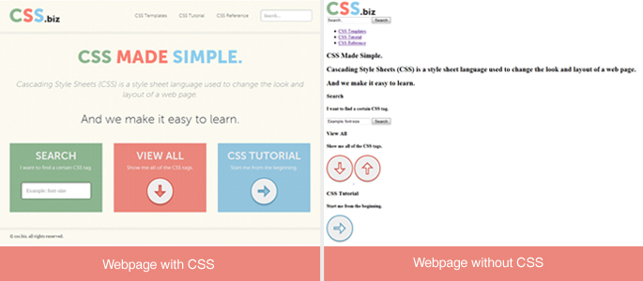
CSS – Cascading Style Sheet
CSS provide style
3 ways to write CSS
CSS inside HTML tag
CSS embedded in the HTML document
CSS in an external file <= RECOMMENDED!!

Slide 20
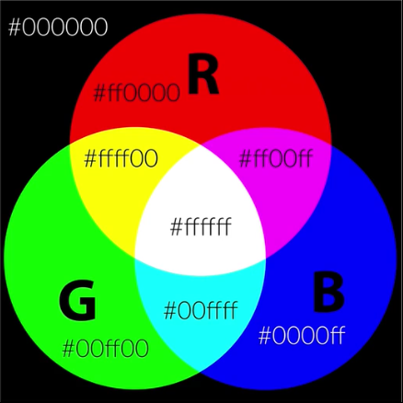
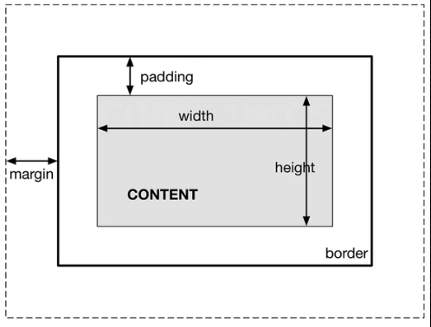
CSS – tips and tricks!
Colors => #RRGGBB
Or rgba(0-255,0-255,0-255, 0-1) // last item is opacity
Class vs id a.k.a (. Vs #)
The box model
Block elements
Uses full width of the browser and enforce line break
In-line elements
Shares the spaces with other elements in the line
Ignore height or width, ignore top and bottom margin
In-line block elements
Similar to In-line element, but can have padding & margins
Doesn’t for a line break
<div> => division => for organization
Positioning…… Relative vs Absolute
Responsive design
Fluid grid (Using percentages)

Slide 21
Website Development Cycle
1. Define your Project
Goal & Audience (Personal website & Recruiters)
2. Plan out everything
Text, images, videos, icons, etc
3. Sketch your ideas before you design
Make wireframes…..revise and repeat!
4. Design and Develop your website
Follow your own guidelines and start developing with HTML & CSS
5. Optimization
6. Deploy your Masterpiece!
7. Site Maintenance => Keep things up-to-date!

Slide 22
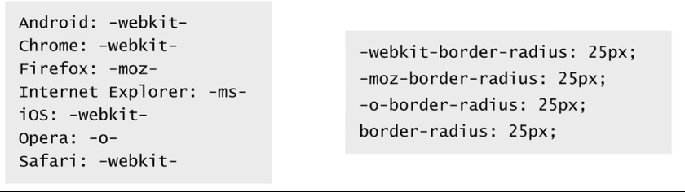
Brackets extensions
Autosave Files on Window Blur
Autosave all open files when switching away from the Brackets editor
Autoprefixer
Adds CSS BROWSER PREFIXES

Slide 23
Useful libraries to import!
Normalize.css => http://necolas.github.io/normalize.css/
Help all browsers render all elements more consistently
Grid.css => http://www.responsivegridsystem.com/calculator/
A simple “Framework” that helps us create responsive websites
Ionicon.css => http://ionicons.com/
High quality icon fonts
Respond.js => http://www.jsdelivr.com/?query=respond
Allows our CSS3 to render normally on out-of-date browsers
Html5shiv.js => http://www.jsdelivr.com/projects/html5shiv
Allows our HTML5 to render normally on out-of-date browsers
selectivizr.js => http://www.jsdelivr.com/projects/selectivizr
Allows us to use newer CSS functions (ex. Last-child, first-child) in Internet browser 6-8
Bootstrap <FRAMEWORK> <- for Navigation bar
Formspree <API> <- for emailing
Validate your HTML
by using a validation
Tool called “validator”:
www.validator.w3.org
To check what functions are available for your browser check with:
http://caniuse.com/

Slide 24
Launching the website!
Choose and buy a domain name (www.myname.com)
Buy web hosting
GoDaddy.com, digitalocean.com, AWS, google, Redhat, etc
Upload our website! (domain name/cpanel)
Easy way is to create FTP account
Download a FTP plugin in bracket: FTP-Sync Plus
Server: FTP Server name (from the FTP application)
Username: Cpanel Username
Password: Cpanel Password
Root: /public_html
This is the file path of where your files will be uploaded in.

